Slide 1
static const int CU_SLOT_CAPACITY_16 = 16;
//number of GPU warp size (constant)
__shared__ CU_SLOT_BUFFER_TYPE
gpu_Type[CU_SLOT_CAPACITY_16], gpu_Zcrd [CU_SLOT_CAPACITY_16], gpu_Znrm[CU_SLOT_CAPACITY_16]; if(thID < CU_SLOT_CAPACITY_16) { //copy pixel data from cpu to gpu using shared memory. gpu_Type[thID] = cpu_Type [uliSlotDataIdx + thID]; gpu_Zcrd [thID] = cpu_Zcrd [uliSlotDataIdx + thID]; gpu_Znrm[thID] = cpu_Znrm[uliSlotDataIdx + thID]; } __syncthreads();
for (CU_SLOT_BUFFER_TYPE p = 0;
p < CU_SLOT_CAPACITY_16; p++) { //CDUA version bubble sorting unsigned int offset = p - (p / 2) * 2; unsigned int iLeft = 2 * thID + offset; unsigned int iRght = iLeft + 1; if (iRght < CU_SLOT_CAPACITY_16) { if (shouldSwap(gpu_Zcrd[iLeft], gpu_Zcrd[iRght])) { //refer to https://github.com/master-hpc/ mp-generic-bubble-sort/blob/master/generic-bubble-sort.cu swap<T>(& gpu_Type[iLeft], & gpu_Type[iRght]); swap<T>(& gpu_Zcrd [iLeft], & gpu_Zcrd [iRght]); swap<T>(& gpu_Znrm[iLeft], & gpu_Znrm[iRght]); } } __syncthreads(); }
class DLLEXPORT STomoPixel { //C++ class for pixel data public: STomoPixel( INT16* _data_6i); ~STomoPixel(); INT16 x, y, z, nx, ny, nz; int iTypeByte;//alpha, beta, TC, …
};
void inline sortSlotByZ(TPVector& slot, bool _Higher) { //pixel data bubble sorting (_Higher) ? std::sort(slot.begin(), slot.end(), _checkHigherPixel) : std::sort(slot.begin(), slot.end(), _checkLowerPixel); }

Slide 2
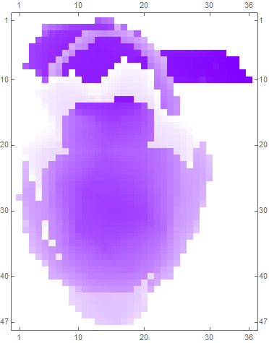
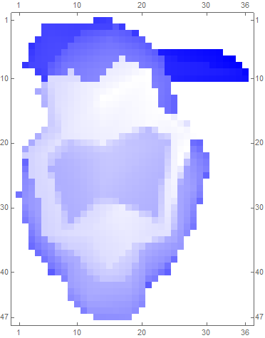
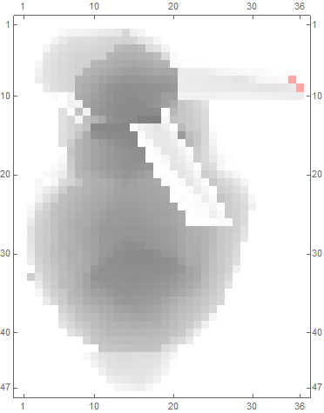
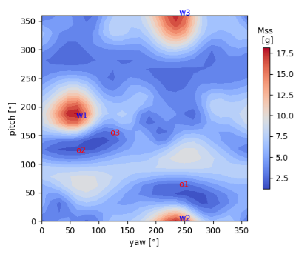
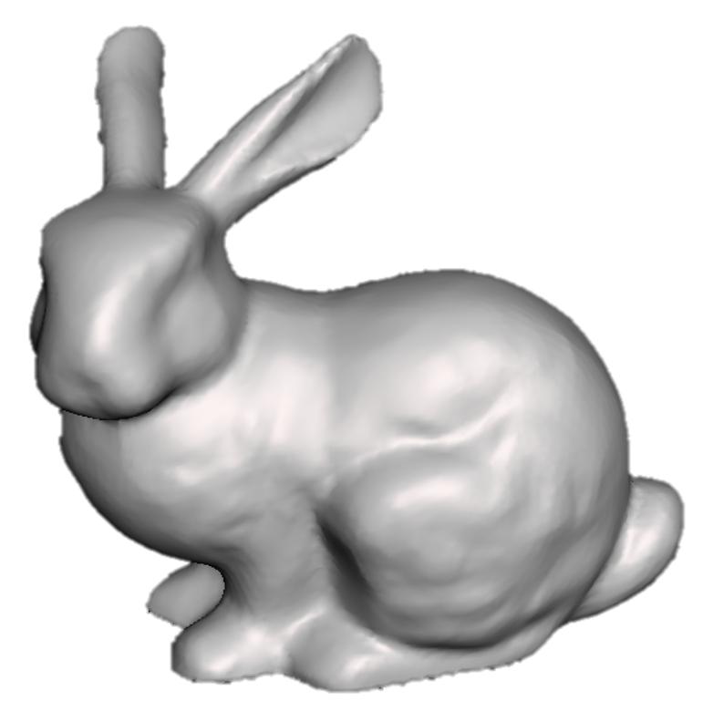
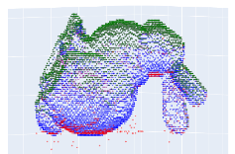
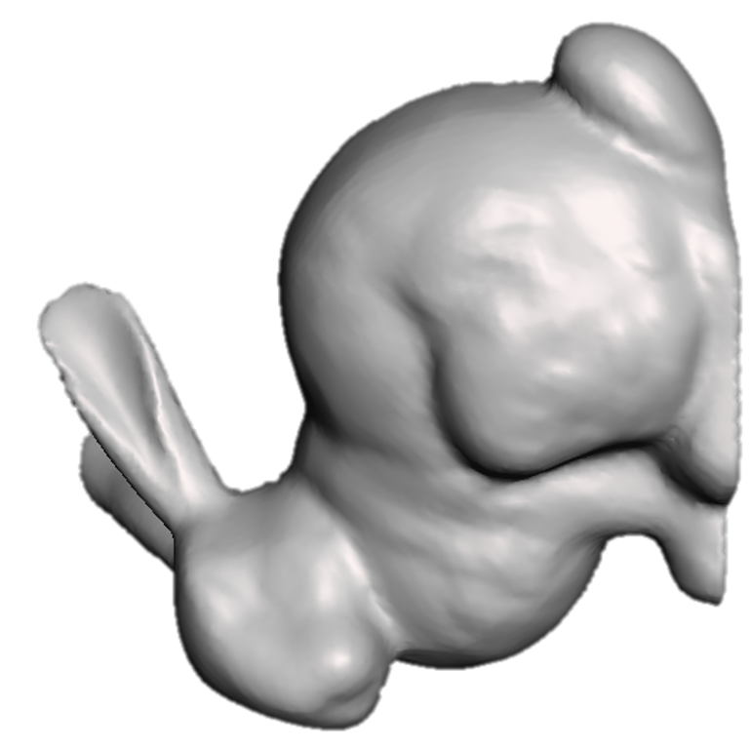
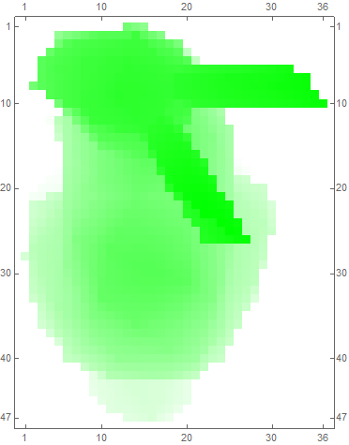
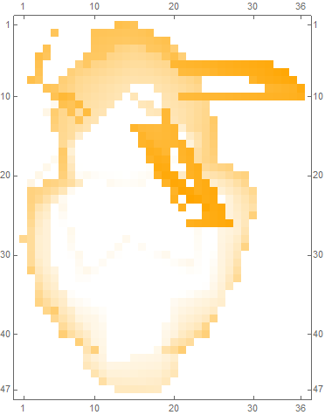
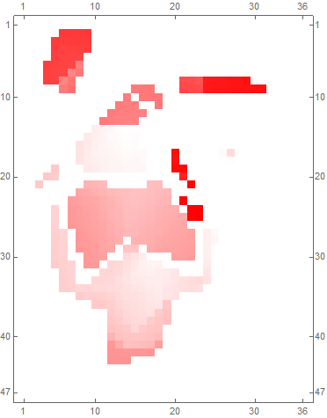
[Modified Support Structure Tomography]
Z (=roll axis)
Z
V_{α}
V _{β}
M_{o}
X
X
(=pitch axis)
-Y
-Y (=yaw axis)
V _{tc}
V _{nv}
M_{ss}
Initial mesh (0°,0°)
Rotate mesh by (yaw, pitch)
Sort each slot and classify pixel group
Integrate volumes
Integrate masses
Plot M_{total} (=M_{o}+M_{ss}) at (yaw, pitch) coordinate
Increase yaw and pitch by θ_{yp} respectively

Slide 3
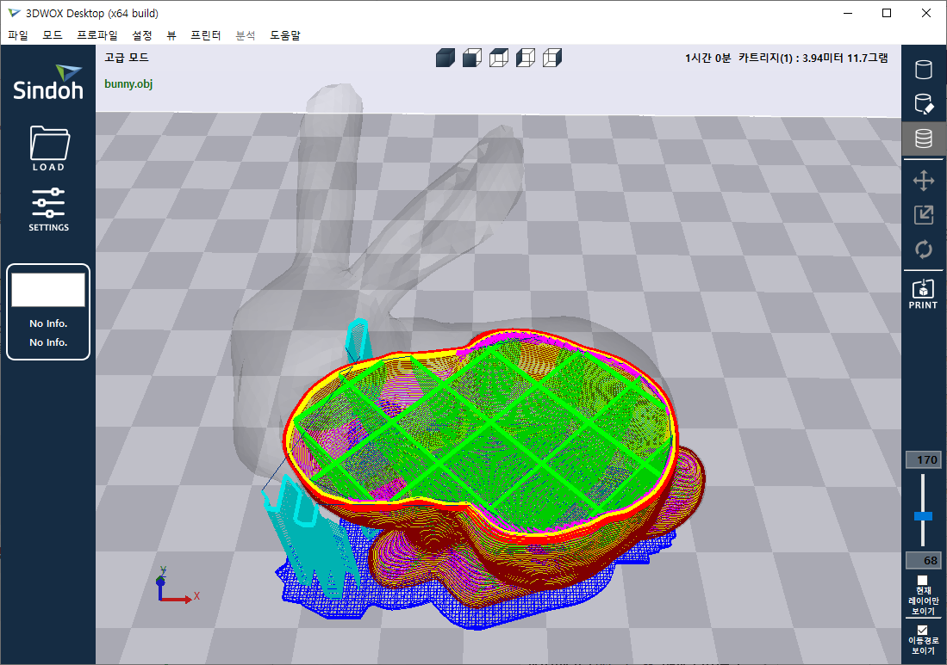
platform
structure
support
structure (“SS”)
wall
(“clad”)
infill
(“core”)
support structure line width / horizontal expansion (“C_{ss}”)
Wall
thickness
(“T_{clad}”)
build plate
(“bottom”)

Slide 4
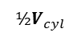
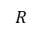
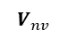
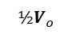
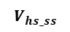
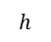
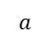
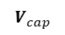
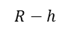
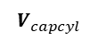
$${½V}_{cyl}$$
$$R$$
$$R−h$$
$${½V}_{o}$$
θ_{c}
$$V_{capcyl}$$
θ_{c}
$$a$$
$$V_{nv}$$
$$h$$
$$V_{cap}$$
$$V_{hs_ss}$$

Slide 5
Y
Slot header
0th pixel
1st pixel
14th pixel
255
_{nV}
V_{o}
V_{ss}
_{Tp}
_{z}
_{nZ}
_{Tp}
_{z}
_{nZ}
_{Tp}
_{z}
_{nZ}
(x,y,*)
₀
₀
₀
₀
₀
₀
₀
₀
₀
₀
₀
₀
₂
₂₂
₃
₁
₃
₋₄₅₆
₂
₂₅
₉₉₉
₀
₀
₀
X
₂
₂₂
₃
₂
₂₅
₉₉₉
₁
₃
₋₄₅₆
₀
₀
₀
0
255

Slide 6
2nd division
(CPU)
1st division
(CPU)
Voxelization
(GPU)
1mm

Slide 7
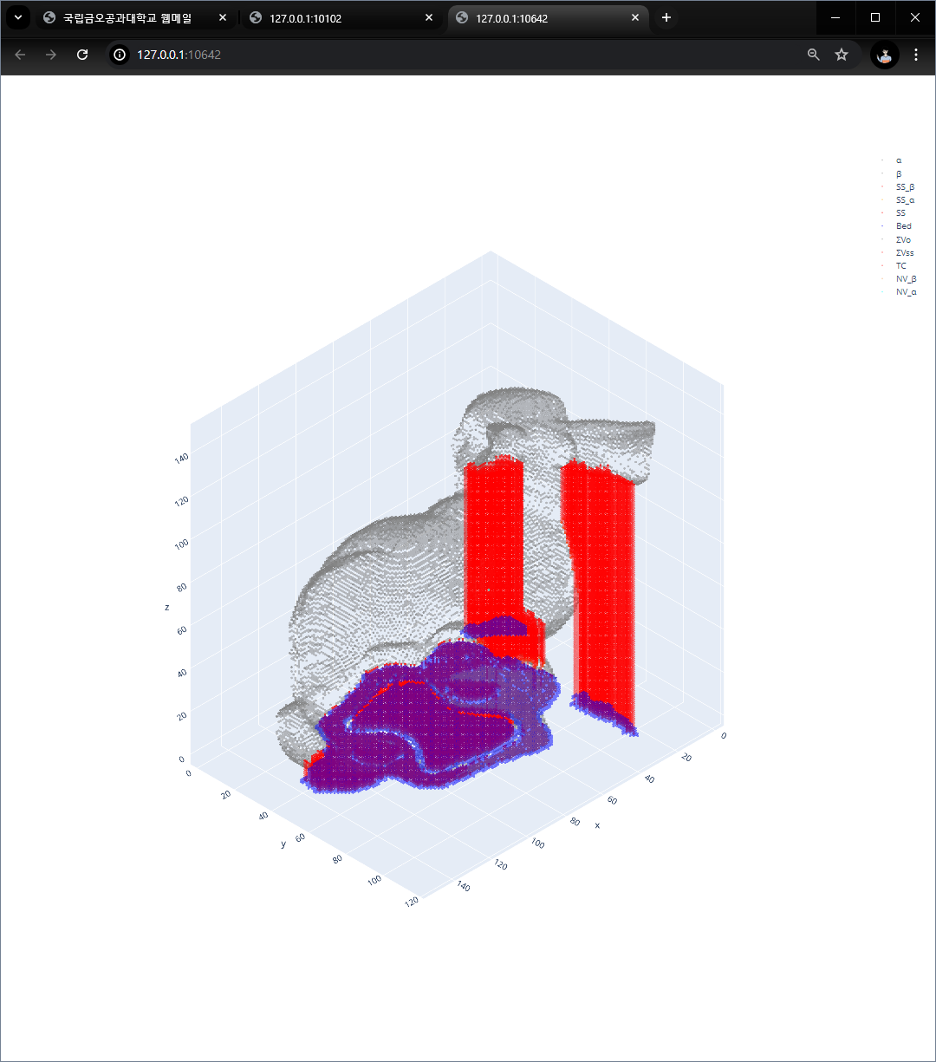
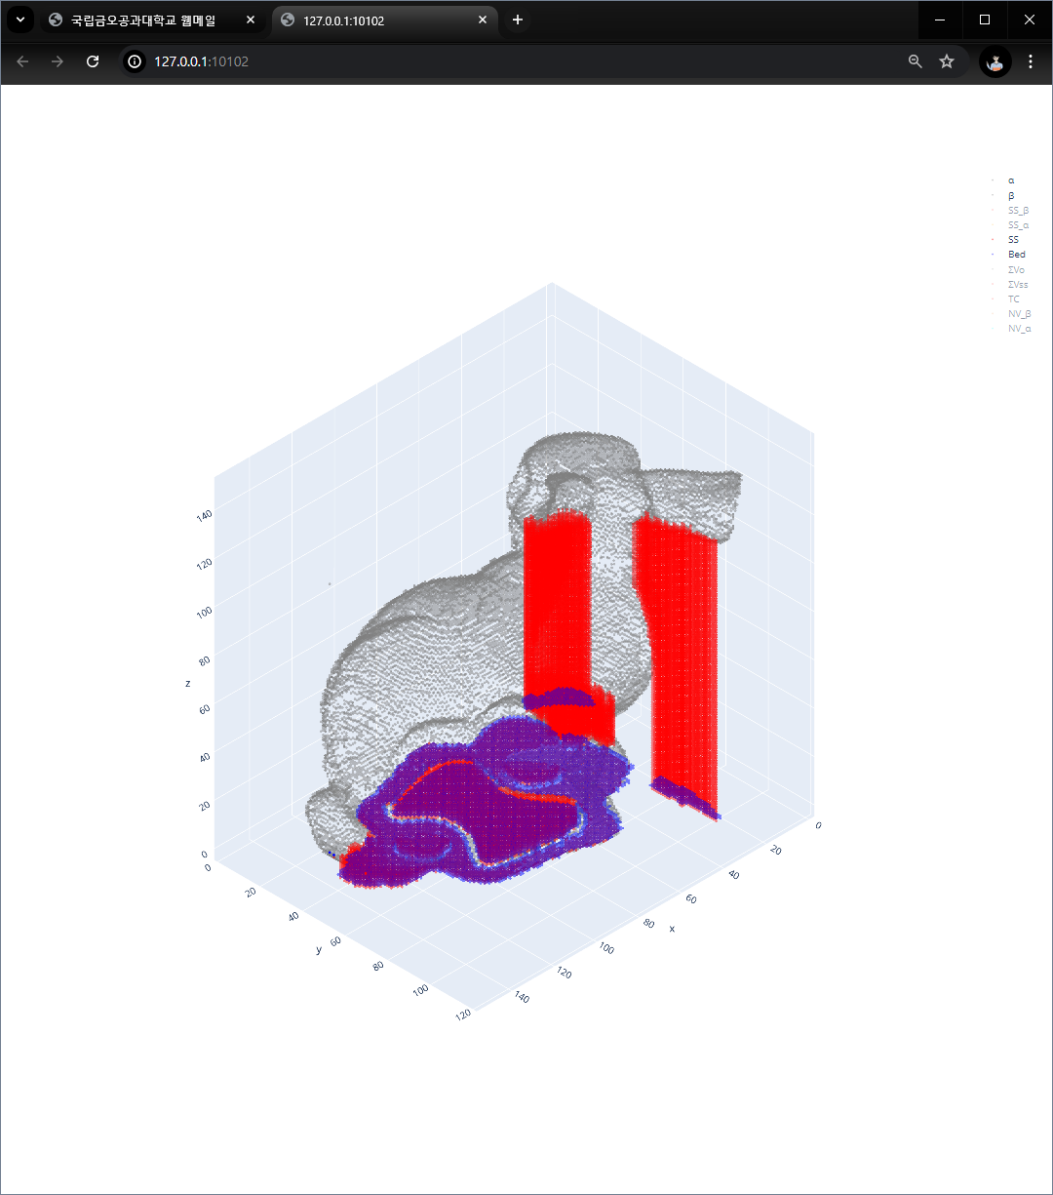
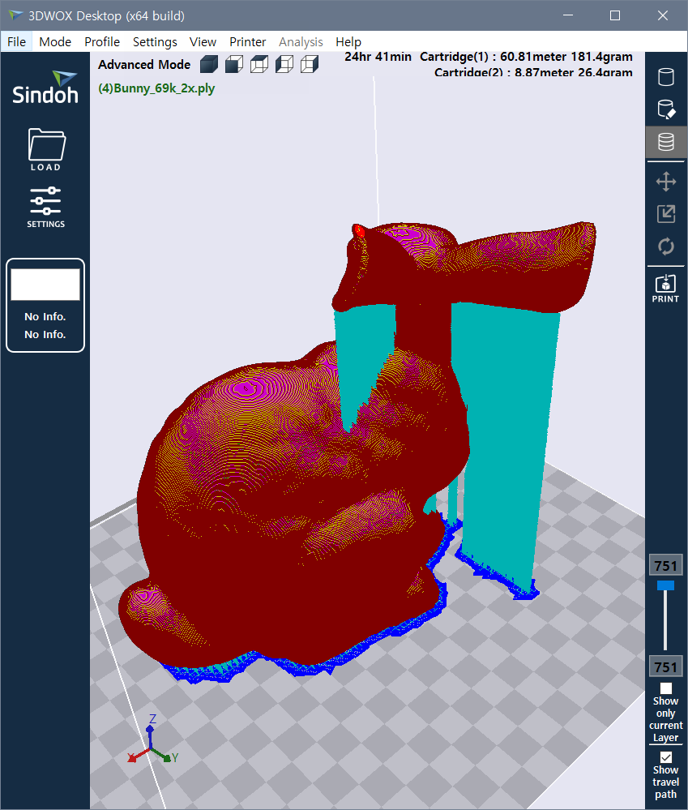
Mo3D= [['169.76']]
Mss3D= [['20.69']]
Mtotal3D= [['190.45']]
Mo3D= [['170.39']]
Mss3D= [['16.99']]
Mtotal3D= [['187.37']]
Mo3D= [[‘181.4']]
Mss3D= [[‘26.4’]]
Mtotal = 207.5
CPU1 (M_{total}= 190.45 g)
GPGPU version (M_{total}= 187.37 g)
Figure 7. voxelization result for Bunny 69k 2x at (0°,0°) orientation (red: support structure, blue: bottom structure)

Slide 8
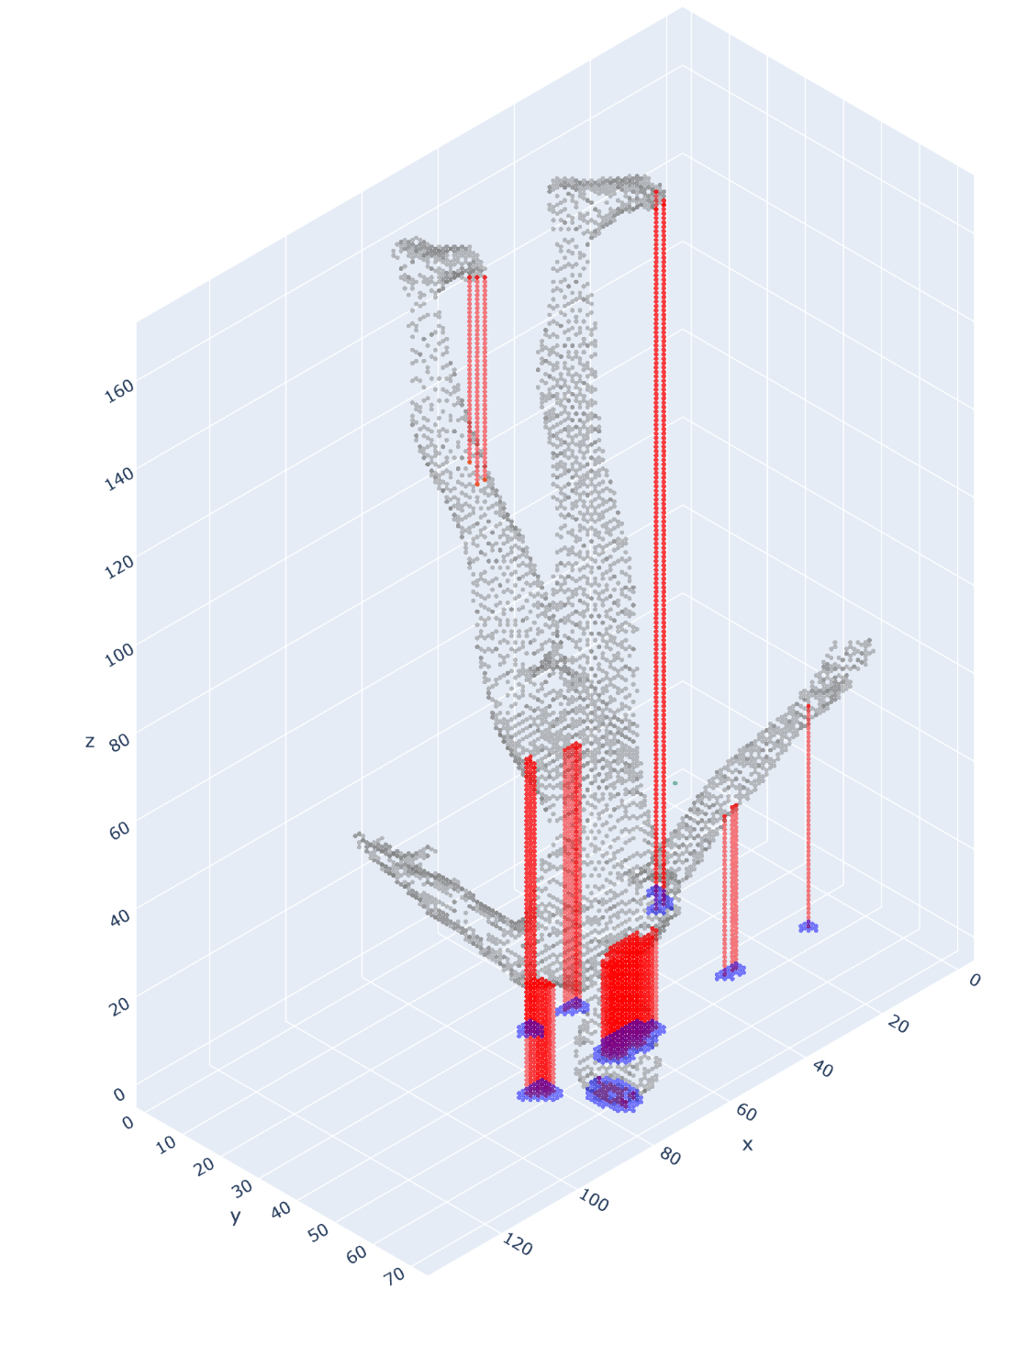
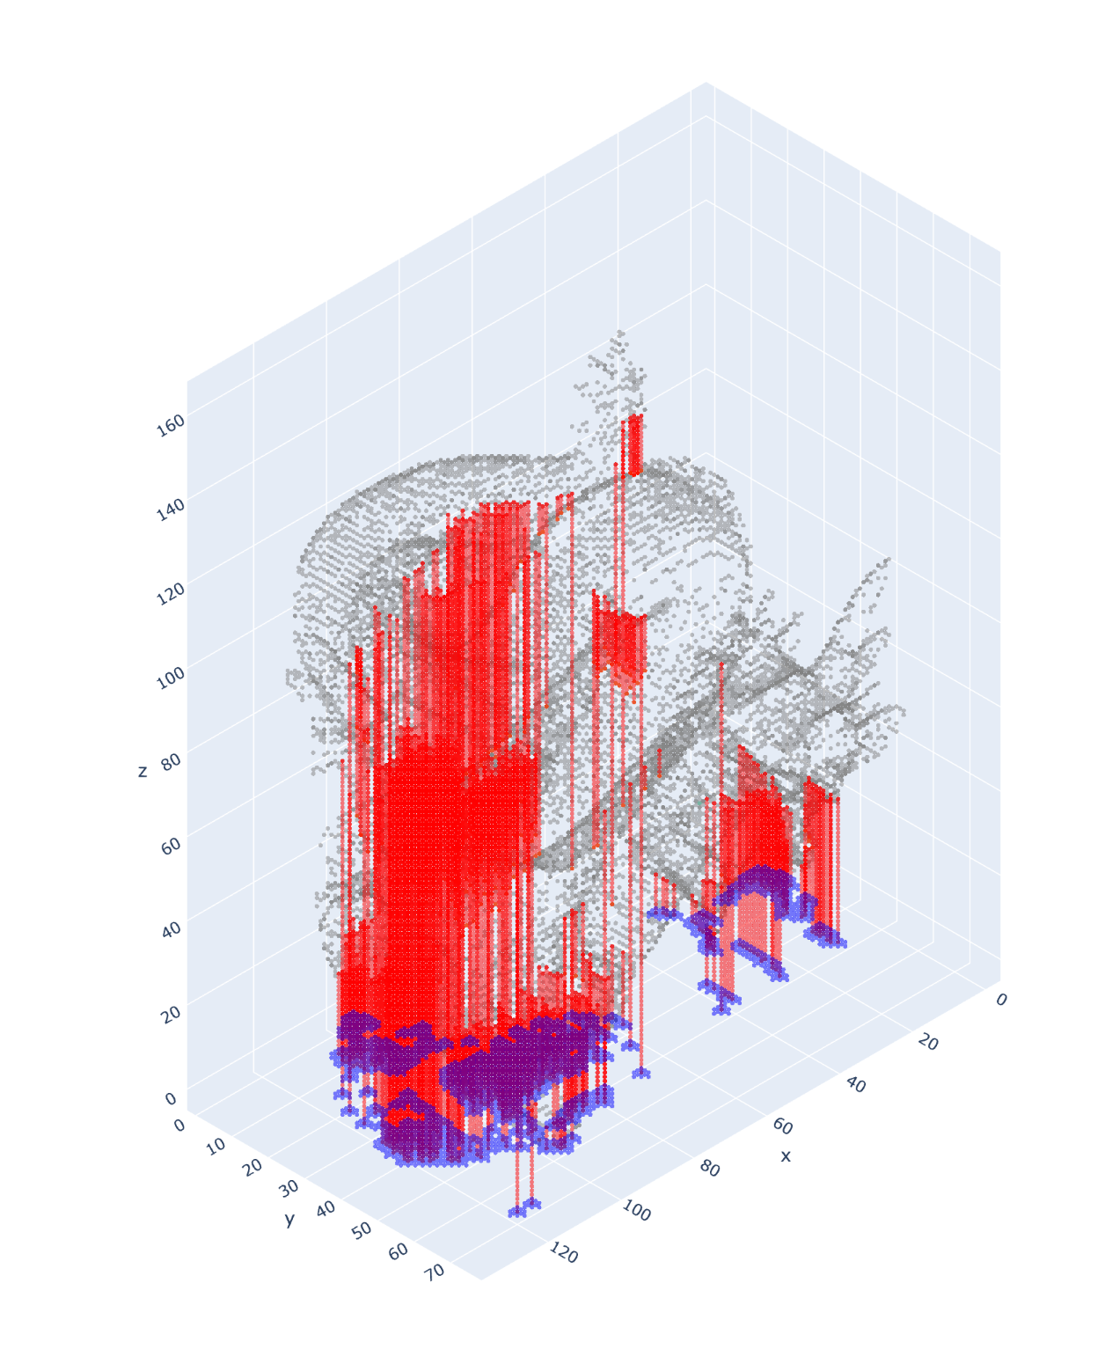
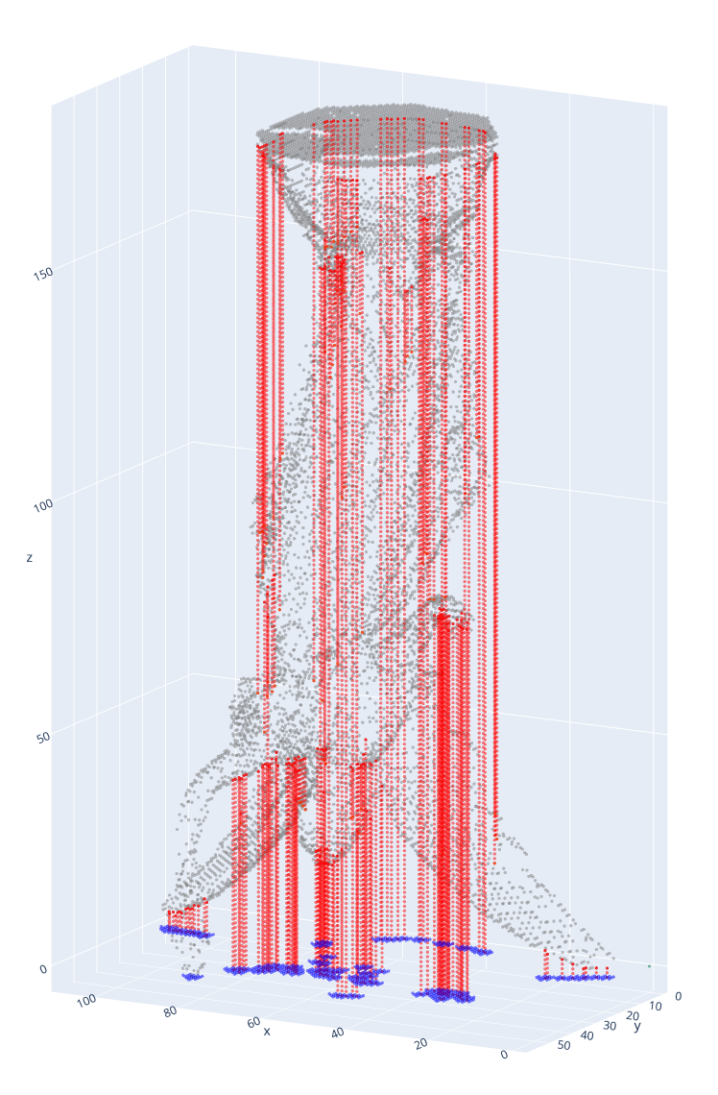
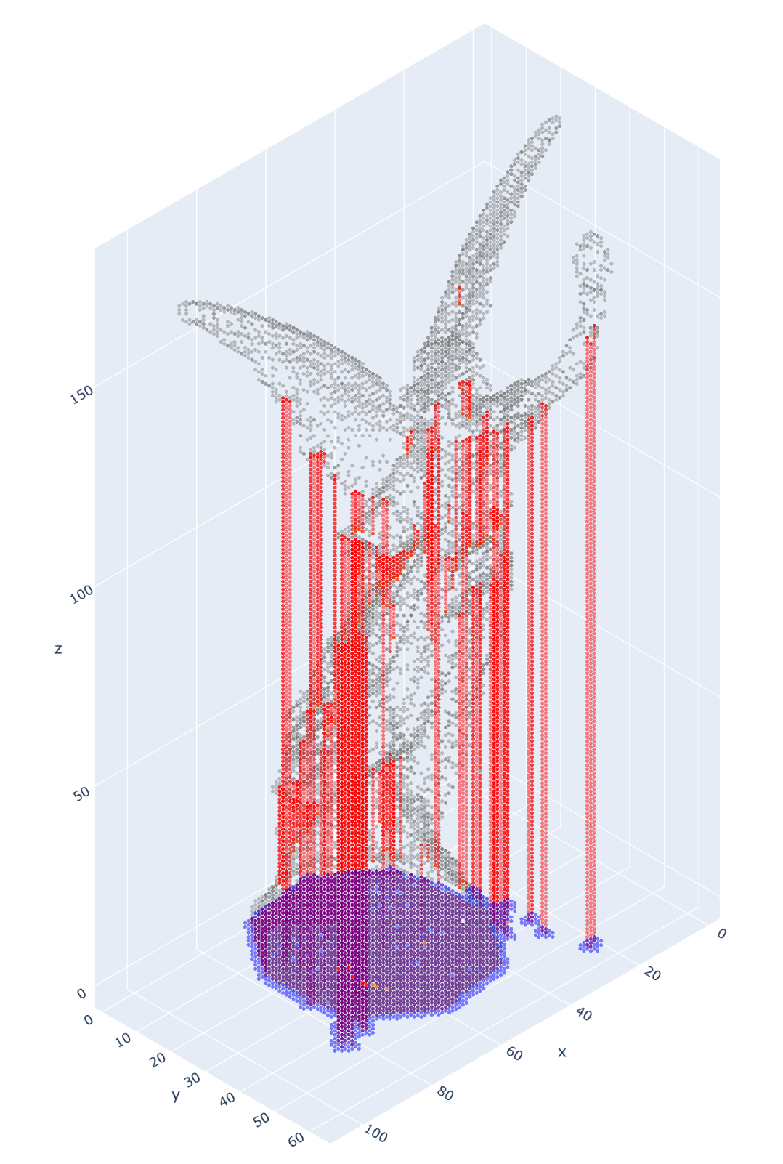
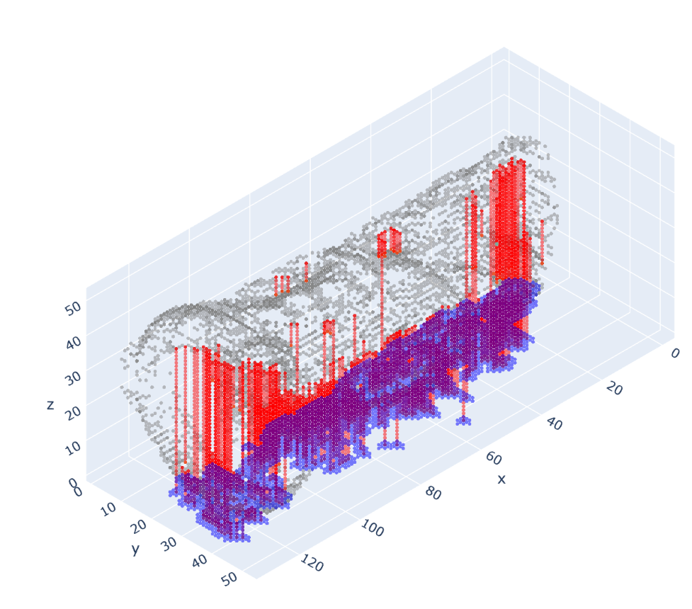
#10 drg (0°,282°)
M_{total}= 96.6g
#9 mnk (85°,181°) M_{total}= 23.3g
#11 Buda (0°,90°) M_{total}= 37.2g
#12 Lucy (179°,0°) M_{total}= 54.9g

Slide 9
slicer Mss
CPU1 Mss
GPU1 Mss
slicer Mo
CPU1 Mo
GPU1 Mo
slicer Mss
CPU1 Mss
GPU1 Mss
slicer Mo
CPU1 Mo
GPU1 Mo

Slide 10
Center of mass
2nd division
(CPU)
1st division
(CPU)
Voxelization
(GPU)
1mm

Slide 11
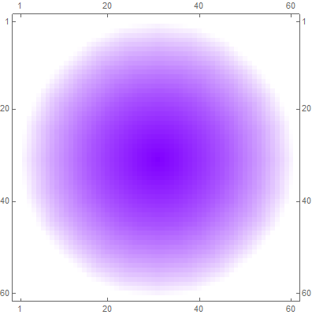
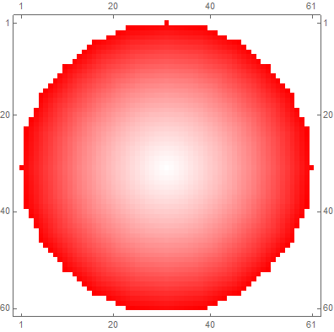

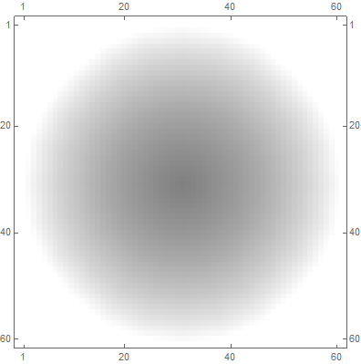
tomoSP (shadow Pyramid) / tomoSO (shadow Orbital)
For each triangle M, repeat
Z (=roll axis)
Find triangle N’s, visible by M within θ_{c}
X
(=pitch axis)
-Y (=yaw axis)
Create pyramid graph for each M/N pair
Initial (yaw, pitch) =(0°,0°)
Composition of all the pyramid graphs
+Vbed
Add shadow volume between bed plate (convex hull)

Slide 12
Y
255
Slot header
0th voxel
1st voxel
2nd voxel
(nV-1)^{th} voxel
(x,y)
Slot (x,y)
_{nV}
V_{o}
V_{ss}
_{Tp}
_{z}
_{nZ}
_{Tp}
_{z}
_{nZ}
_{Tp}
_{z}
_{nZ}
_{Tp}
_{z}
_{nZ}
X
0
255

Slide 13
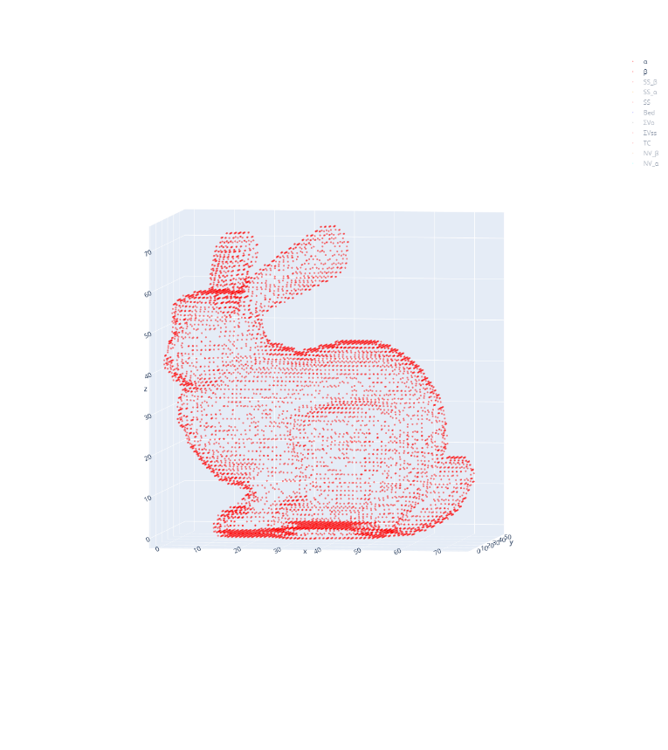
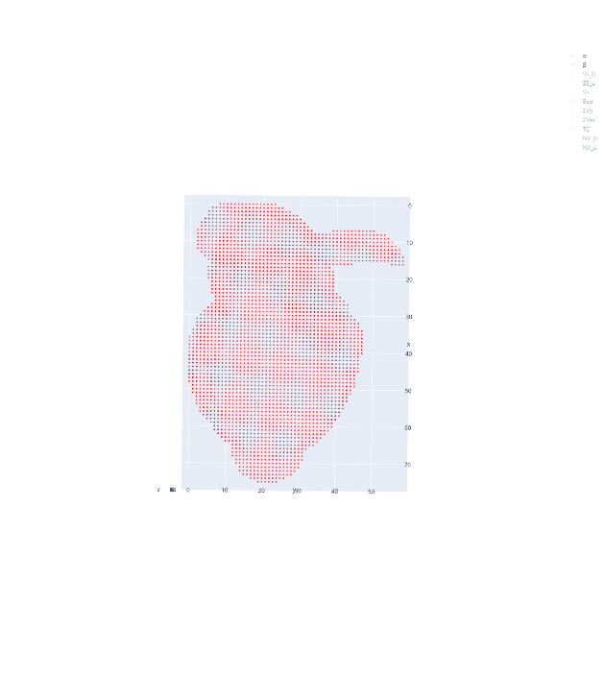
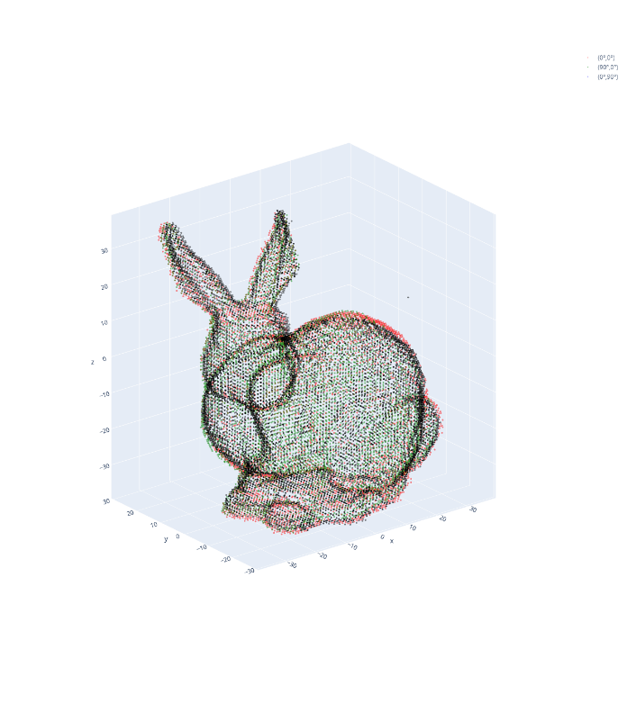
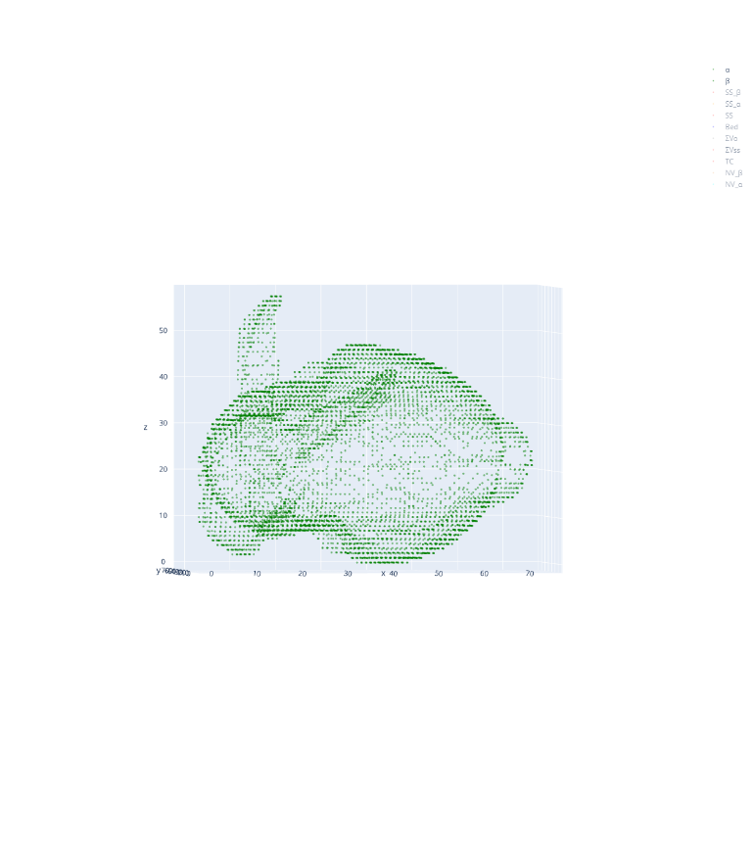
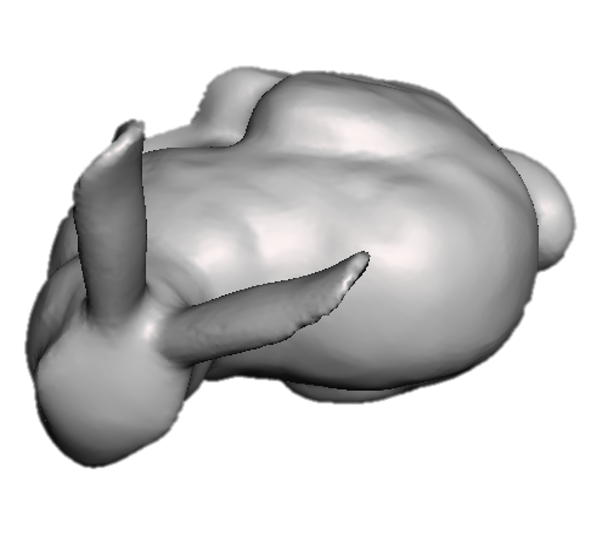
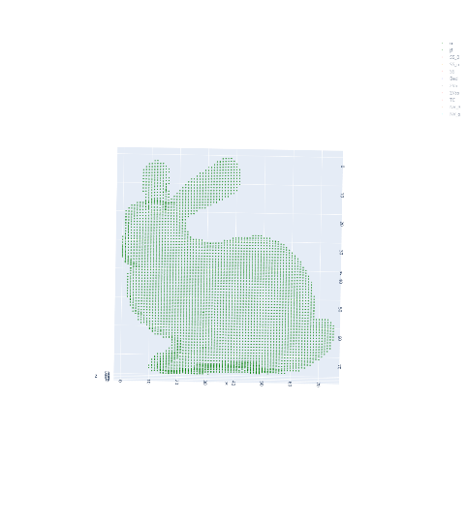
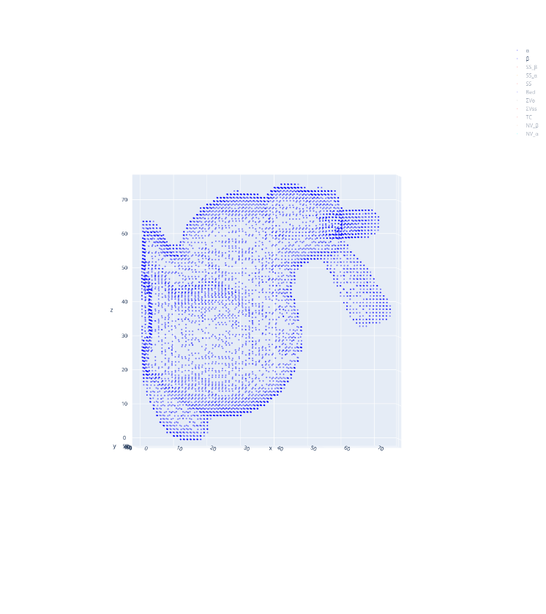
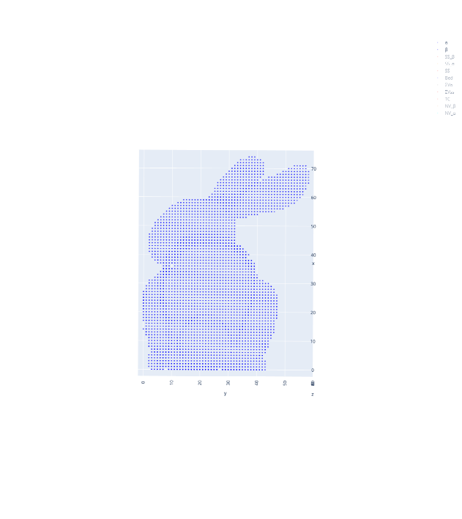
Z (=roll axis)
(top-view)
X (=pitch axis)
-Y (=yaw axis)
Input mesh, (0°,0°)
( 0°, 0°)
VSV at (0°,0°)
(top-view)
(90°, 0°)
Z
( 0°,90°)
rotation
X
Inverse rotation & addition
(90°,0°)
-Y
VSV at (90°,0°)
(top-view)
Z
Final CVV
X
-Y
(0°,90°)
VSV at (0°,90°)

Slide 14
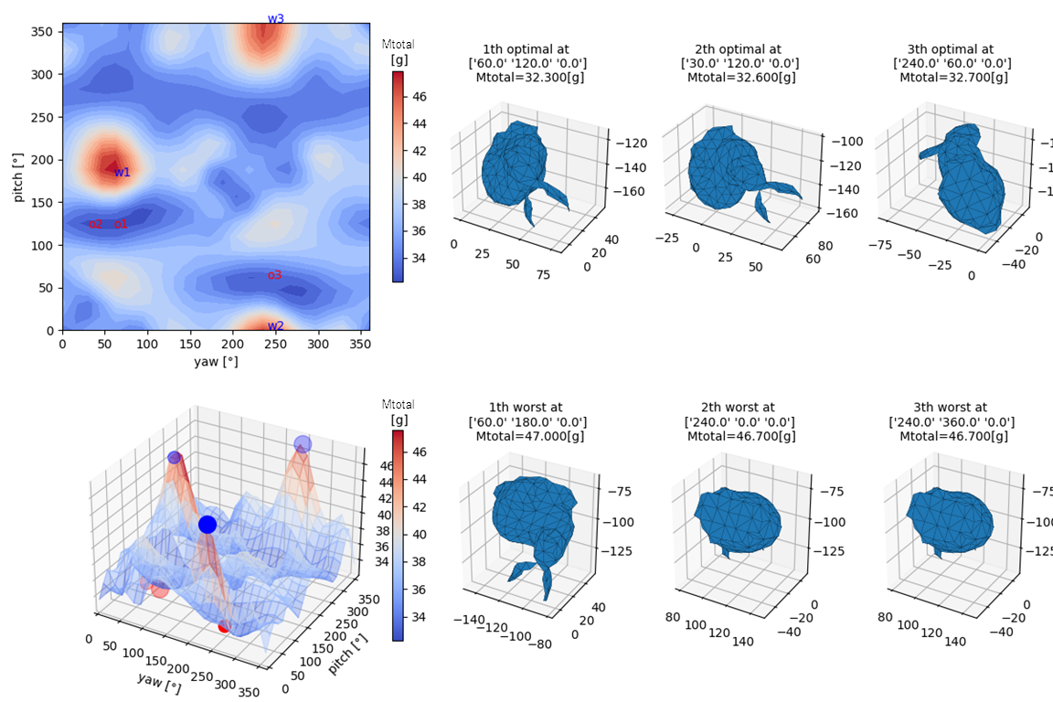
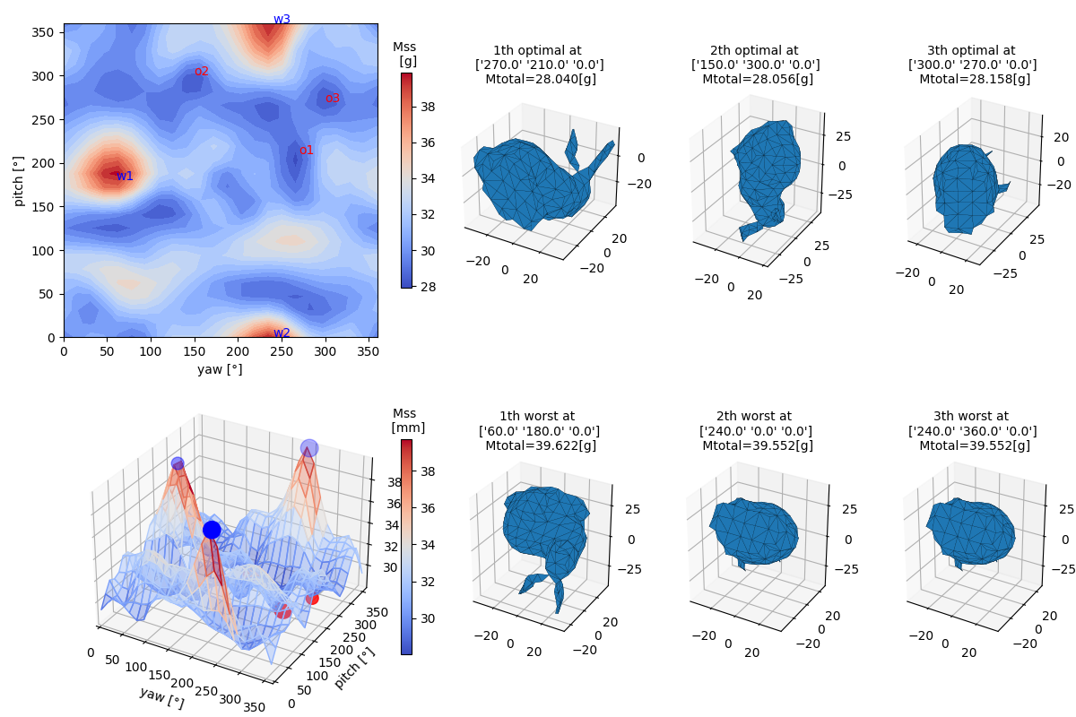
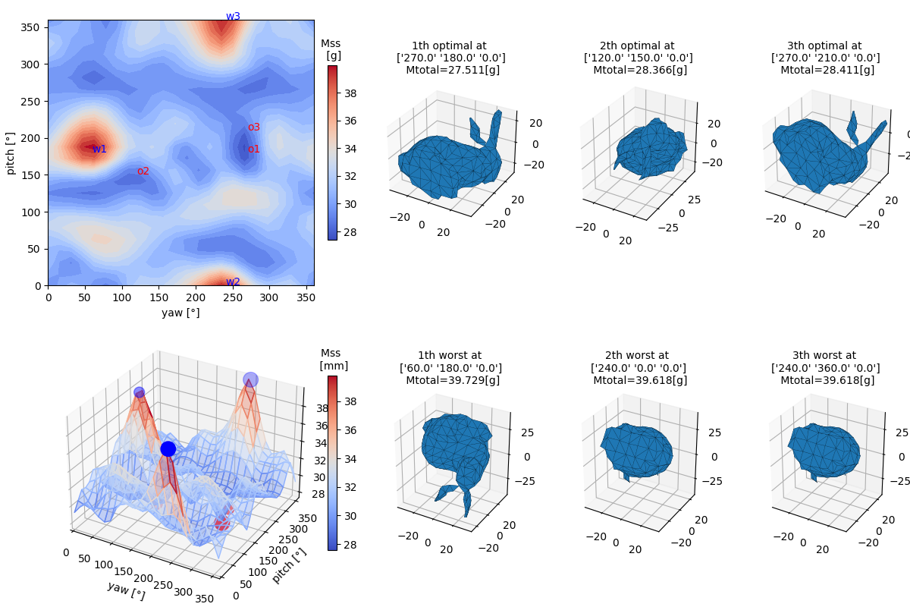
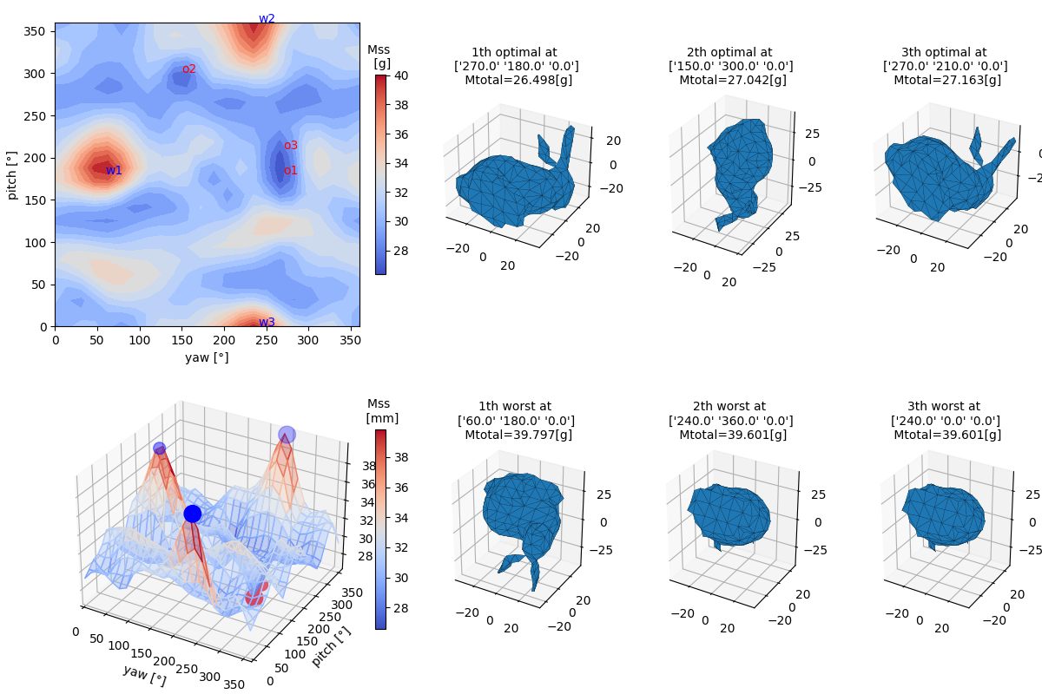
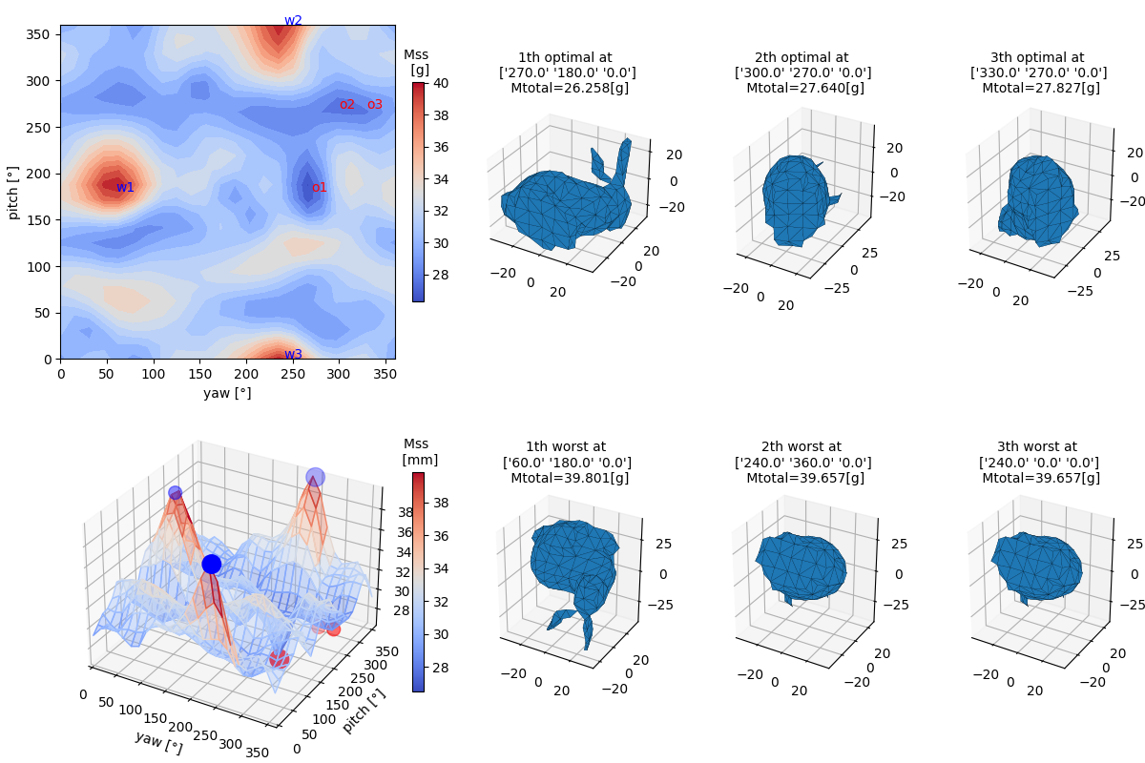
#5 Bunny 69k (30° interval, raft bottom structure)
slicing SW (3DWOX)
VSV
CVV2
CVV3
CVV1

